Slide 1

RGB Color Detector using TCS3200 Color Sensor & Arduino
HEMANATHAN C - 190701067
HARISH RAJAA M - 190701063
LAKSHMI PRASATH S - 190701106

Slide 2
INTRODUCTION
Vision is the most important part of human physiology as 83% of information human being gets from the environment is via sight. The count of visually impaired people rises every year. A Color detector can be a tool that senses or detects colors.
The system presents a concept to provide a smart electronic aid for color blindness people, both in public and private space.
This system uses Arduino Uno R3 as a microprocessor. The sensor senses the color and sends this information to the microprocessor, which as per the programming code interprets the input from the sensor and gives the output in the form of different intensities of primary colors, which if mixed, will give the color sensed by the sensor.

Slide 3
MOTIVATION
The motivation behind making this project is to make the life of blindness people easier as much as possible, to solve the complex problems of this world through which we can make this globe a better place for living.
This world is full of colors which drive me to make a setup which can tell someone about the color of a particular thing. So this is the driving force which makes this imagination turning into reality.

Slide 4
EXISTING SYSTEM
Design and Development of Color Sorting Robot for color sensing and sorting.
Color and object based color sorting using embedded systems for color detection.
Designing a system to extract colors out of images and filter the images based on those colors.
Extraction of colors from the collection of images using K Means algorithm.
Low cost color sensors for monitoring plant growth in a color sensing arm robot.
Threshold based segmentation
Gaussian mixture model
Color histogram and gradient based segmentation.

Slide 5
LITERATURE SURVEY
S.NO | TITLE OF THE PROJECT | AUTHOR AND YEAR | PROBLEMS ADDRESSED BY THE PAPER | METHODOLOGY USED | LIMITATION OF THE SYSTEM
1 | Design of low cost flexible RGB color sensor | M. Moghavvemi; S. S. Jamuar; E. H. Gan; Y. C. Yap | Design of low cost, high speed portable color sensor suitable for use in external light environment susceptible to disturbances is presented. | The color identification is based on sensing Red (R), Green (G) and Blue (B) colors reflected from the object using an ambient light phototransistor. | It allows the sensor to detect various colors at different distance with only one calibration and does not require calibration with eight colors before its use in measurement system
2 | An Intelligent Color Sensing system for building wall | Abhishek Singh; Nagesh B. Balam; Anuj Kumar; Ashok Kumar Year: Sept 2018 | An intelligent color sensing system has been developed. The developed system is capable of the measurement of color of building wall. | The color sensing system is implemented using arduino processing unit with white Light Emitting Diodes (LED | The ICS system is easy to operate, energy efficient, accurate, and transportable. But it is highly expensive and hard to afford

Slide 6
3 | Fiber Optic Sensor For Color Detection | Journal of Lightwave Technology Published: 1999 | The design and implementation of a novel fiber-optic sensor which detects the color of a remote object is described. | The sensor is inherently more sensitive than conventional color sensors and is suitable for use by robots. | Shows the experimental setup of fiber optic color sensor. As it is easy to use yet highly expensive.
4 | A vision tracking system via color detection | 2018 International Conference on Information and Communications Technology (ICONTACT) Published: 2018 | a vision tracking system via color detection is presented. In this system, a monocular camera is used as a sensor to track and measure the relative pose of the target based on specified color detection with the help of four LED markers. | An UAV is used as a platform to test the effectiveness of the system. | Experimental results show that the proposed system can track the target (UAV) in a constant speed very well.

Slide 7
PROPOSED SYSTEM
A colour sensor can detect the received light intensity for red, blue and green respectively, making it possible to determine the colour of the target object.
The motivation behind making this project is to make the life of people easier as much as possible, to solve the complex problems of this world through which we can make this globe a better place for living. This world is full of colors which drive me to make a setup which can tell someone about the color of a particular thing. So this is the driving force which makes this imagination turning into reality.

Slide 8
OBJECTIVES
The main objective to recognise and detect the colours of objects to help the colour blindness people.
An important challenge in color detection and similar technologies is the ability to handle all those situations where subjects (whose color is to be detected) are not in close range and hence color cannot be differentiated and hence detection becomes tough and may lead to wrong results or no results.

Slide 9
CHALLENGES
Connections are complicated. With change in one circuit will collapse the entire circuit.
Color sensor is way more sensitive and that should be handled accordingly
Color detection can be done wrong if it doesn’t maintain a proper distance between the sensor and the color object.
polished or reflective color objects are hard to detected when it comes light emitting color detection sensor

Slide 10
SYSTEM ARCHITECTURE
Power Supply
Color Sensor (TCS3200)
Arduino (UNO)
LCD Display
Serial Monitor

Slide 11
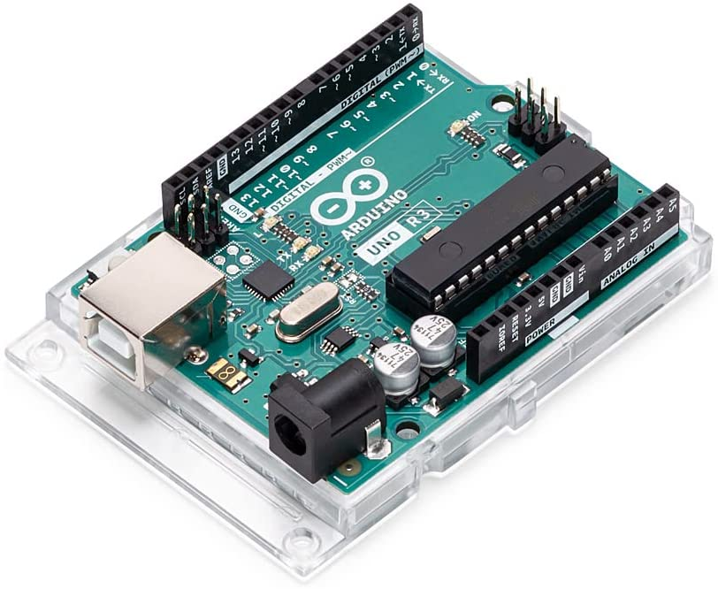
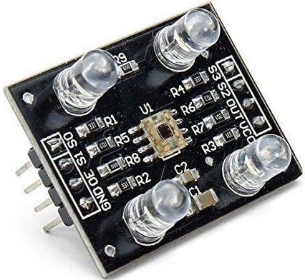
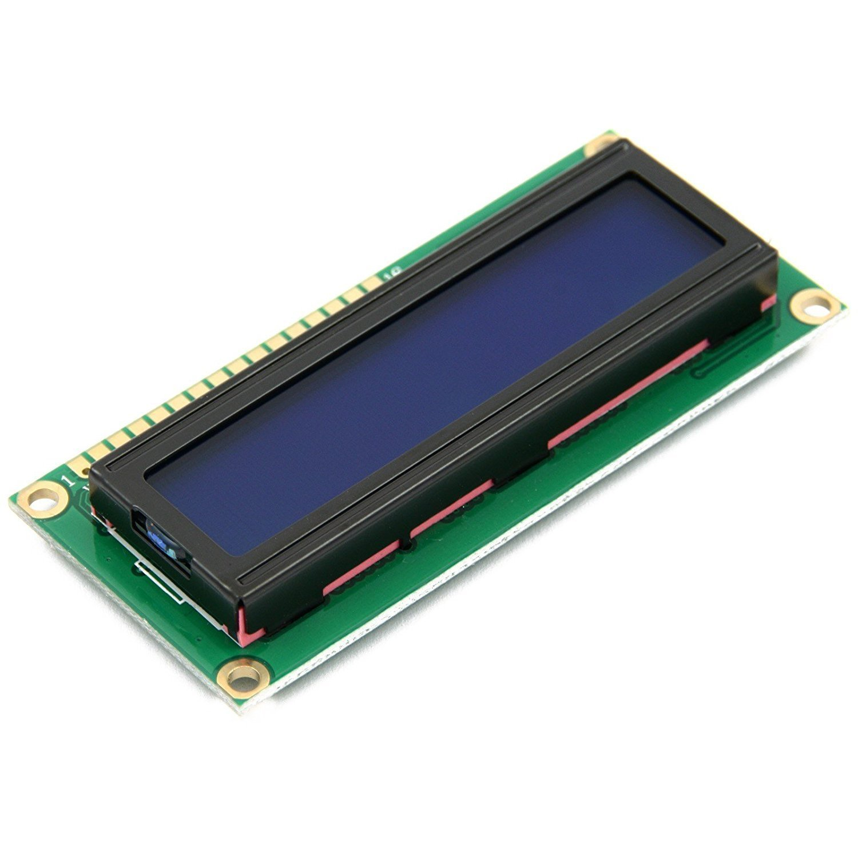
MODULES
Arduino Board (UNO)
Color Sensor (TCS3200)
LCD Display Screen(16 pin)

Slide 12
REFERENCES
X. Fang, K.S. Hsiao, V. P. Chodavarapu, A.H. Titus, and A.N. Cartwright, “Colorimetric porous photonic bandgap sensors with integrated CMOS color detectors,” IEEE Sensors Journal, vol. 6, no. 3, pp. 661-667, June 2006.
Z. Fu and A. H. Titus, “CMOS neuromorphic optical sensor chip with color change-intensity change disambiguation,” IEEE Sensors Journal, vol. 9, no. 6, pp. 689-696, May 2009.
S. Sahu, P. Lenka, S. Kumari, K. B. Sahu, and B. Mallick, “Design a color sensor application to robot handling radiation work,” IEEE International Conference on Industrial Electronics, Control & Robotics, Piscataway.
M. Seelye, G. S. Gupta, D. Bailey, J. Seelye, "Low cost color sensors for monitoring plant growth in a J. Nandhini, K. Sabatini, S. Karthikeyan, "Wireless color sensing arm robot", IEEE International Conference on Robotics Automation Control and Embedded Systems, pp. 1-6, 18–20 Feb. 2015.
Uzma Amin, Ghulam Ahmad, Nudrat Liaqat, Manzar Ahmed, Sumbal Zahoor “Detection & Distinction of Colors using Color Sorting Robotic Arm in a Pick & Place Mechanism” International Journal of Science and Research (IJSR) ISSN.

Slide 13
REFERENCES
LIM JIE SHEN*, IRDA HASSAN ”Design and Development of Color Sorting Robot ” EURECA 2014 Special Issue January (2015).
Aji Joy “Object Sorting Robotic Arm Based on Color Sensing” International Journal of Advanced Research in Electrical, Electronics and Instrumentation Engineering Vol. 3, Issue 3, March 2014.
Dhanoj M, Reshma K V, Sheeba V, Marymol P “Color Sensor Based Object Sorting Robot Using Embedded System” International Journal of Advanced Research in Computer and Communication Engineering vol. 4, Issue 4, April 2015.
Abhishek Kondhare, Garima Singh, Neha Hiralkar , M.S.Wanjale “Color And Shape Based Object Sorting” International Journal Of Scientific Research And Education ||Volume||2||Issue|| 3 ||Pages|553-562||2014|| ISSN (e): 2321-7545.
Li Qiaoyi “Study on Color Analyzer Based on the Multiplexing of TCS3200 Color Sensor and Microcontroller” ijhit Vol 7, no 5 (2014).

Slide 14
THANK YOU

